Slide 1
MVC and databases tutorial Part 2 – Validation, Filtering, Styling and Images

Slide 2
Before you begin
Please complete Part 1 of this tutorial, so that you have the application that is the starting point for this tutorial
If anything has gone wrong with that code, you can find it on the VLE in the Week 4 - ASP.NET folder. It is in the note MVC Movies – Main Functionality

Slide 3
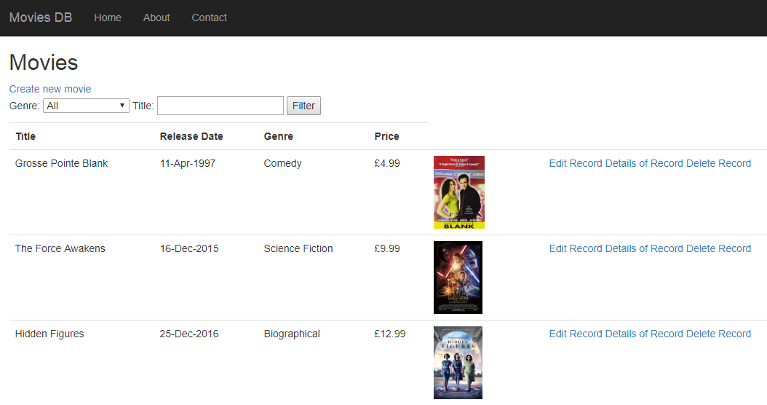
The application being created
This is an MVC5 application with a single-table SQL database
It has Create, Read, Update and Delete (CRUD) functionality
It has filtering and searching
A database-first approach is used to create the database, which is then attached to the project by creating an ADO.NET Entity Framework model

Slide 4
Validation

Slide 5
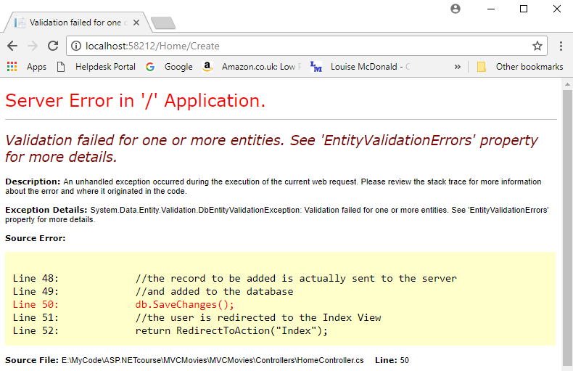
User input validation
If you were to try an add a blank record in the Create view, you would get an error like this
It’s important to stop users doing things like this, so that the database doesn’t contain invalid data and the application doesn’t crash
User input validation prevents the user from adding records with incomplete or invalid data to the database
This needs to be implemented in the Create and Edit action methods and views
We also need to protect other views from invalid record ids (because these appear in the URL, they could be changed or deleted by a user)

Slide 6
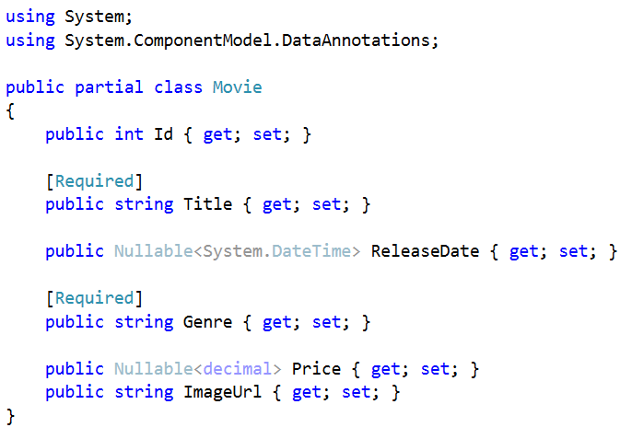
Data annotations
MVC’s approach to user input validation starts with the rules for each property being entered in the model class
This means the rules are only entered once and are then consistent throughout the application
Data annotations are used to implement the rules
The simplest data annotation is to make a property required by adding [Required] above the property
This should be done for all properties that are NOT NULL in the database
These will be all the properties that don’t have Nullable in the model class, with the possible exception of strings, which can always take null values in C#
The Id doesn’t need data annotations, as it is never entered by users
Properties with nulls allowed in the database can be required in the software if you choose
You will also need using System.ComponentModel.DataAnnotations;

Slide 7
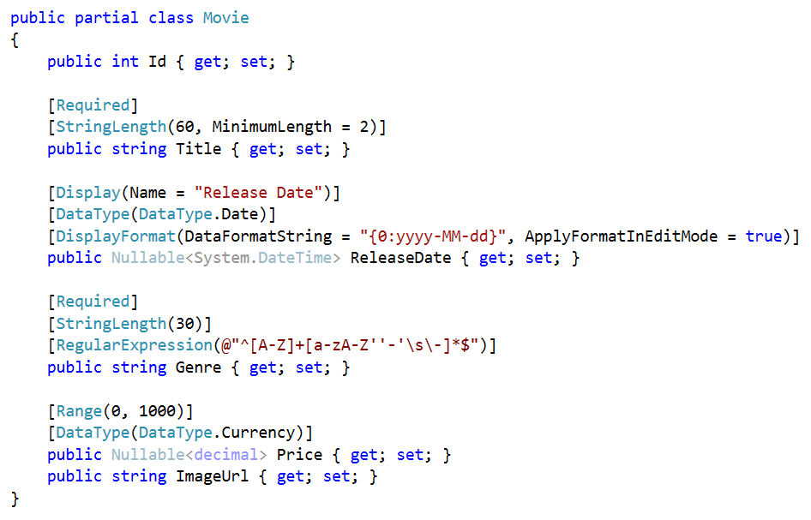
Data annotations
Maximum and minimum length of data input
Setting the label for the data to something other than the database column heading, e.g. to have spaces between words or make the label more user-friendly
This changes the display of the date from date and time to just date
This changes the display format of the date. It works properly in Firefox and IE, but not in Chrome or Edge
This is a regular expression, which can be used to check patterns of text, e.g. email addresses. The pattern here is: start with a capital letter, then have 0 or more letters, spaces, hyphens or apostrophes
This sets the range of any numerical value
This displays a currency symbol – see the next slide to choose which currency symbol is displayed

Slide 8
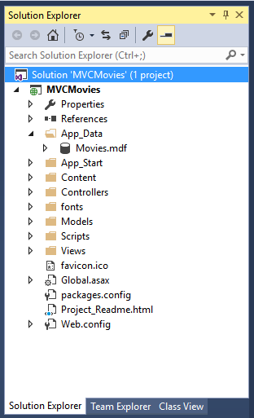
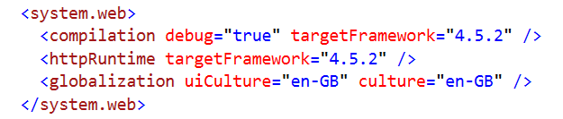
Setting the £ sign
You will have noticed that Price now has a currency symbol, because it has a data annotation to say that it is currency
The currency symbol that you see depends on the culture settings of your machine
If the culture on your machine is set to British English, you will see a £ sign. If it’s set to another country and language, you will see the currency symbol for that country
The culture on the servers of your hosting service may be different, which means the currency symbol could change when you deploy your application
That means it is important to set the culture in your application, as this will override the machine settings on your local machine or hosting service
You can do this in the Web.config file (the one at the bottom of the file tree in the Solution Explorer):
Add this line inside the <system.web> tags:
<globalization uiCulture="en-GB" culture="en-GB" />
Other culture codes can be found at:
https://msdn.microsoft.com/en-us/library/system.globalization.cultureinfo(vs.71).aspx

Slide 9
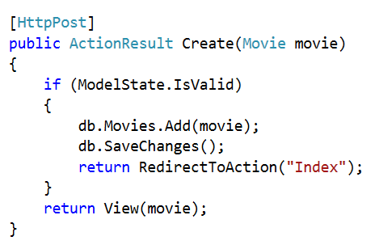
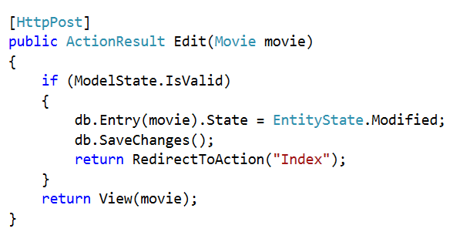
Making data annotations work
You have added rules for user input validation as data annotations, but the application doesn’t yet enforce them, so it will still crash if invalid data is entered
To make this happen, you need to add some extra code to the POST Create and Edit action methods in the Home Controller
Please add an if (ModelState.IsValid) statement and put the code for the database changes and the return to the Index view inside it
If the data isn’t valid, then the user should be able return to the Create or Edit view and have a chance to fix the faulty data
Now if you run the code and try to add an empty record or edit an existing record so that it’s invalid, you will stay in the Create or Edit view
However, a user might not know what had gone wrong, so it would be helpful to give them some error messages

Slide 10
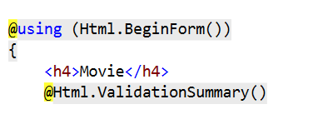
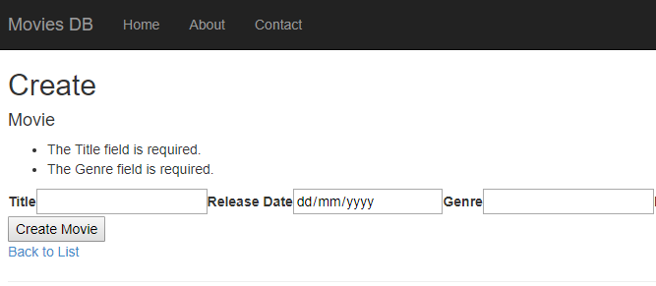
Adding error messages
The easiest way to add error messages is to add @Html.ValidationSummary() to the Create and Edit views, just under the Movie heading
Now, if you try to add a blank record you will get error messages

Slide 11
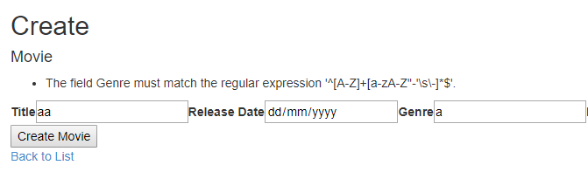
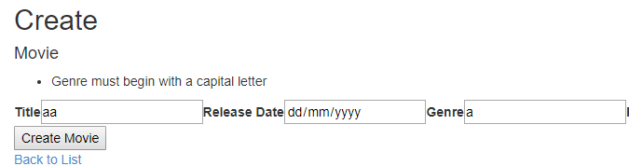
Customising error messages
At the moment, you are using the default error messages from the data annotations
Some of these are not very user-friendly
You can add a custom error message to any data annotation

Slide 12
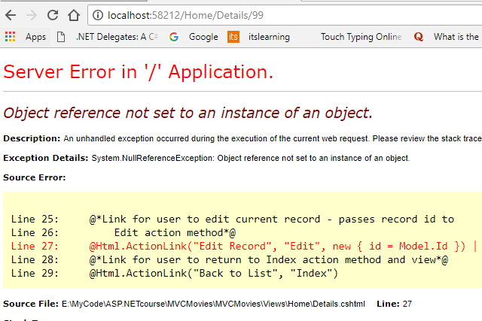
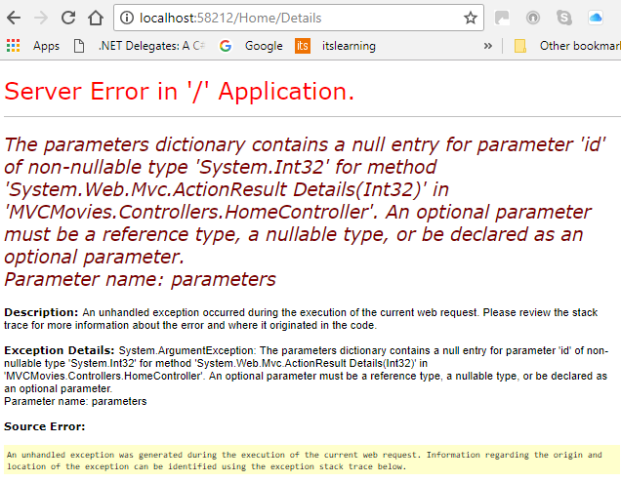
Dealing with missing or invalid ids
MVC routing means that record ids are passed between controllers and views using the URL
That means that the id in the URL could be changed
If an invalid id were entered, the code would crash
A similar crash occurs if the id is blank

Slide 13
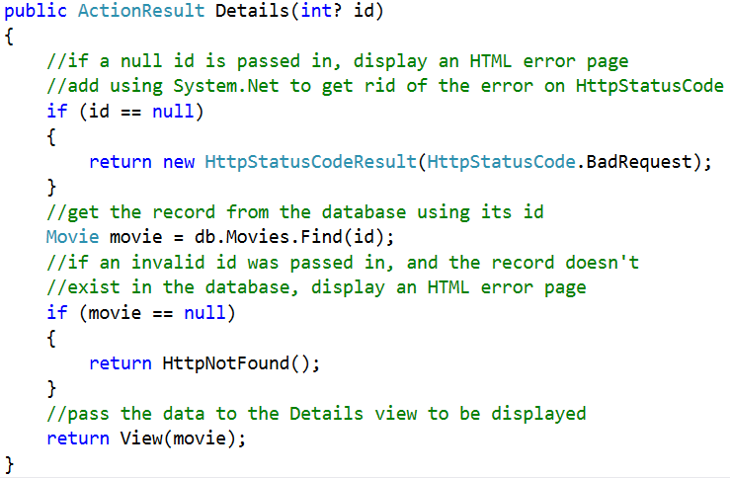
Dealing with missing or invalid ids
It is possible to prevent these kinds of crashes
In the GET methods which get a movie from the database – Details, Edit and Delete:
Make the input parameter nullable by putting a question mark after the int
Add an if statement to check if the id is null
If it is, call a standard HTML error page
You will need to add using System.Net at the top of the Home Controller to deal with the compilation error on HttpStatusCode
After the database search for the record, add an if statement to check that the record exists
If it doesn’t, call a standard HTML error page

Slide 14
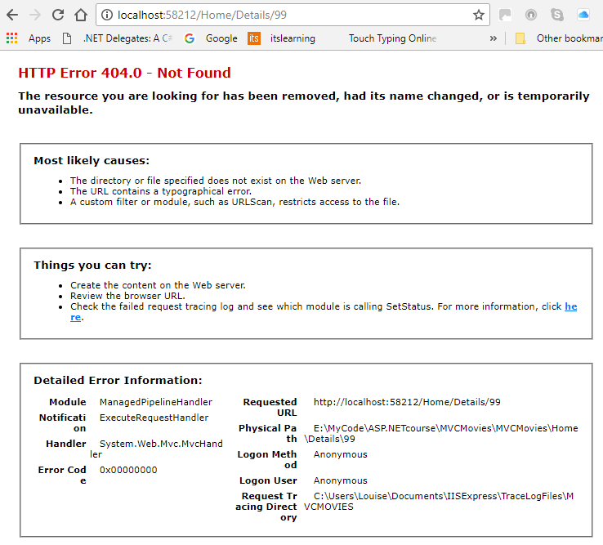
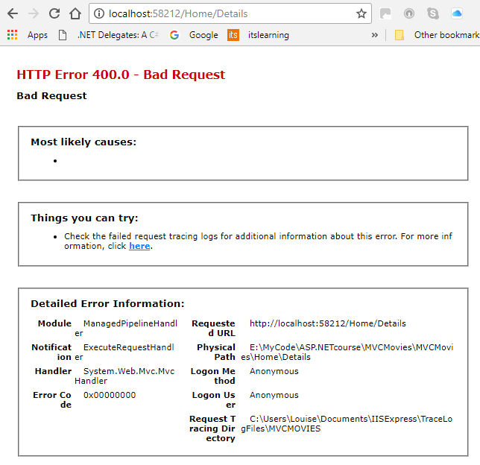
Dealing with missing or invalid ids
Now if an id is missing or invalid, the problem is handled gracefully with standard error pages which give the user intelligible information about what has gone wrong

Slide 15
Searching

Slide 16
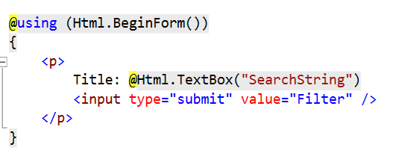
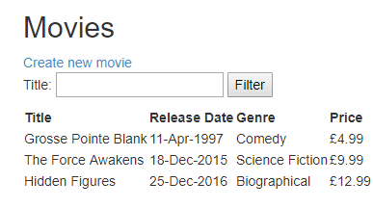
Searching by title
It’s helpful if users can search for a movie by all or part of its title
You can implement this by adding a text box inside a form to the Index view and adding some extra logic to the Index action method in the Home Controller
Start by adding a form, a textbox and a button to the Index view under the <h2>Movies</h2> heading
When you run the code, it should look like this, but the search won’t work yet
This is Html.TextBox (not Html.TextBoxFor) because we are not working directly with the model in this part of the code

Slide 17
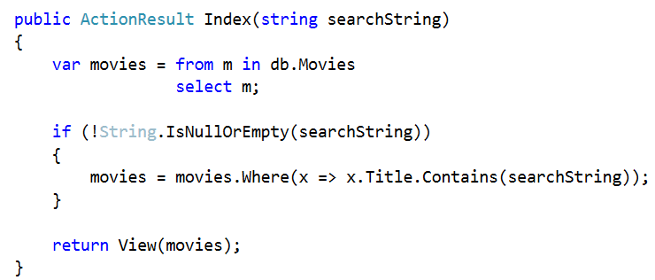
Searching by title
The form in the view passes a string parameter called searchString to the Index action method in the Home Controller
You then use this parameter (if it isn’t empty) to reduce the list of movies to include only those that contain the search string

Slide 18
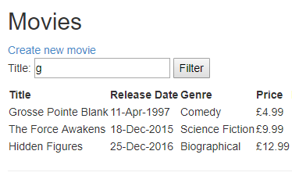
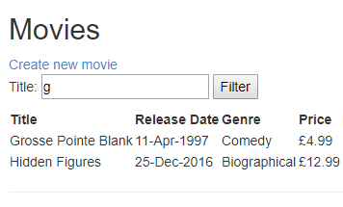
Searching by title
Run the code and type a letter in the text box (ideally one that is only in some of your movie titles)
Click the filter button and your list should be filtered to show only those movies which contain the search string

Slide 19
Filtering

Slide 20
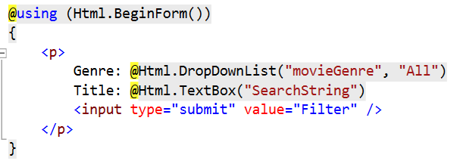
Filtering by genre
It’s helpful if users can filter the data in your application, especially in a real application with dozens of records
Genre is a good category to filter on, as there are likely to be a least a few records in each genre in a larger database
Start by adding a dropdown list to the form in the Index view, just above the text box for the title search
Don’t run the code yet – if you do, you will get an error, as the SelectList hasn’t been created yet
movieGenre is the name of a SelectList that will contain the options for the dropdown list. It will be created in the Index action method and put in the ViewBag so the view can find it. The name of the input parameter of the Index action method should also be the same as this
“All” is the text that will appear at the top of the dropdown list when nothing has been selected

Slide 21
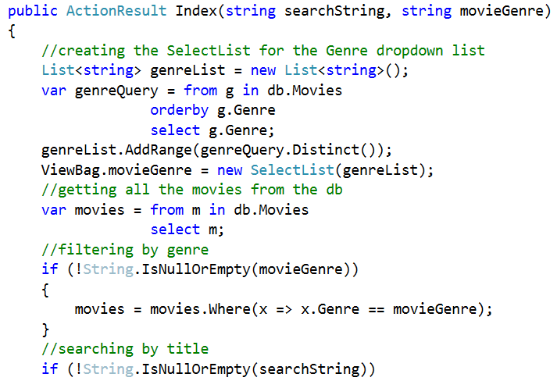
Filtering by genre
In the Index action method, add a string input parameter to get the genre selected from the form in the Index view
Then create the SelectList by:
Creating an empty list of type string
Getting the genres from the db in order
Adding unique genres to the list
Creating a SelectList using the list of genres and putting it into the ViewBag so the view can find it
Further down, filter the movies list by the selected genre that was passed in from the Index view
When you declare the List, there will be a compilation error. Add using System. Collections.
Generic; at the top of the Home Controller to get rid of it

Slide 22
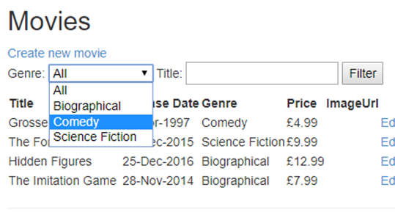
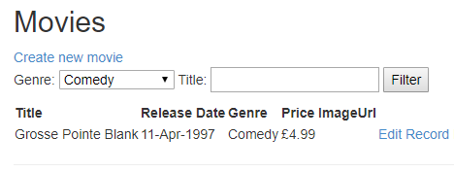
Filtering by genre
Now run the code and you should see a dropdown list for Genre
Make a selection from the list and click the Filter button
Only movies of the correct genre should be shown
Note that each genre is only shown once in the dropdown list, even if there are several movies of the same genre in the database
This is because .Distinct() was used to remove duplicates from the genre list
Also, the genre list will be updated every time a movie with a different genre is added, because the genres were fetched from the database (not hard-coded)

Slide 23
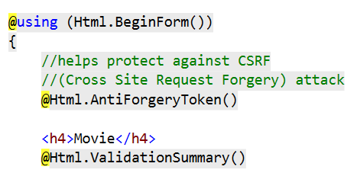
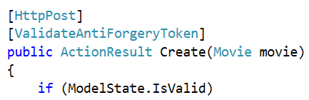
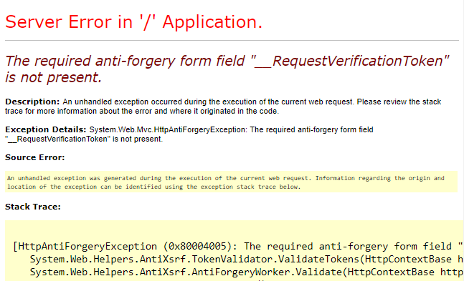
A bit about security
MVC has some features that help make your application more secure
Security is a big topic and it is unlikely that these features will protect against all attacks, but they will help a bit
Anti-forgery tokens can protect against CSRF (Cross Site Request Forgery) attacks
An anti-forgery token is placed in the forms of the Create, Edit and Delete views (i.e. any views that lead to POST action methods that change the contents of the database)
An annotation [ValidateAntiForgeryToken] is put before each of the corresponding action methods
You can test this by commenting out one of the anti-forgery tokens in a view and trying to complete that action – you should get an error like this

Slide 24
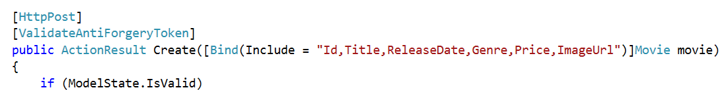
A bit about security
Another security feature is binding, which can prevent cross-site scripting attacks
If you add binding to the input parameter list in the POST Create and Edit methods, this means that only data for those fields will be allowed into the action method

Slide 25
Styling

Slide 26
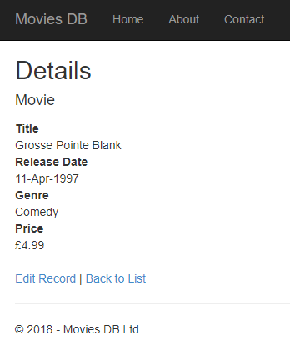
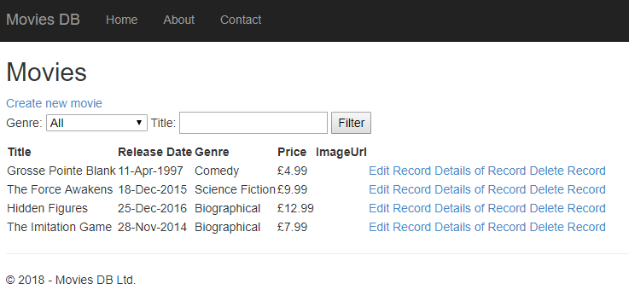
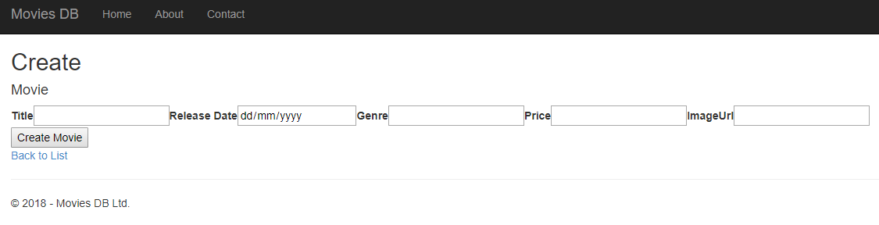
Styling the application
The application works now, but looks messy. It needs styling with CSS and Bootstrap

Slide 27
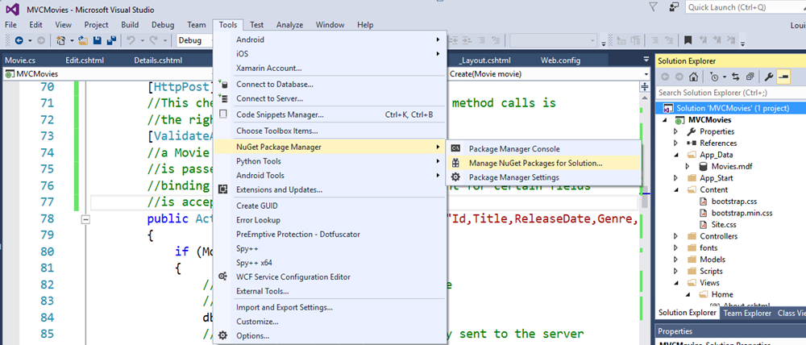
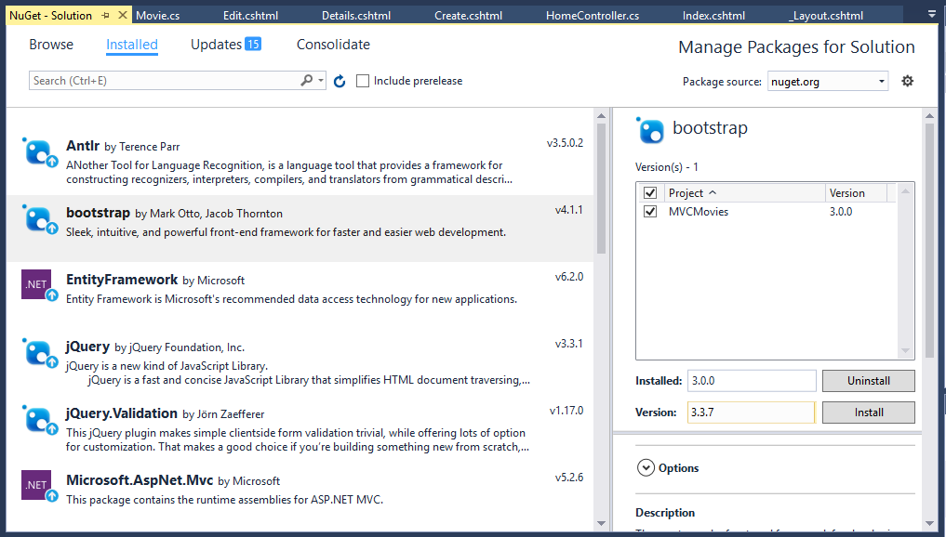
Adding a Nuget package
The version of Bootstrap that comes with the application template that we used is rather outdated, so it’s useful to update it
From the Tools menu, select NuGet Package Manager then Manage Nuget Packages for Solution
Under the installed tab, select Bootstrap
Check the box next to the project name
In the Version box, click and select version 3.3.7 from the dropdown list
Do NOT use later versions, unless you have checked with a trainer, as at least one of them causes serious errors in Visual Studio
Then click the Install button

Slide 28
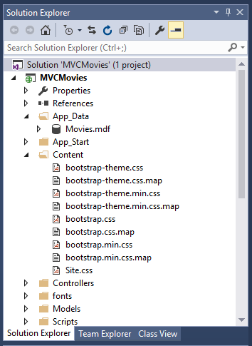
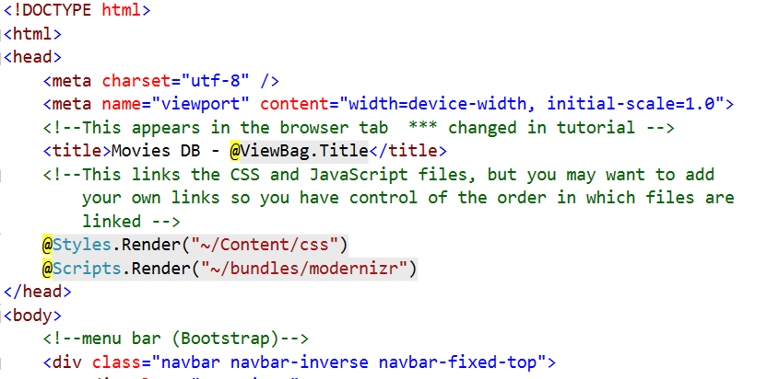
Adding a Nuget package
In the Content folder in the Solution Explorer, you will now see more Bootstrap files. Font and JavaScript files have also been installed
There is also a Site.css file in the Content folder. You can use this for your CSS or add a new file to the folder
CSS, JavaScript and any other files that are used throughout the application, are linked in the _Layout.cshtml in the <head> section
Styles.Render() is used to link to all the files in a bundle
If you want to control the order that files are linked in, comment out Styles.Render() and use <link> tags to link your files in the correct order
You can find more details of which files are included in each bundle in the BundleConfig.cs file in the App_Start folder

Slide 29
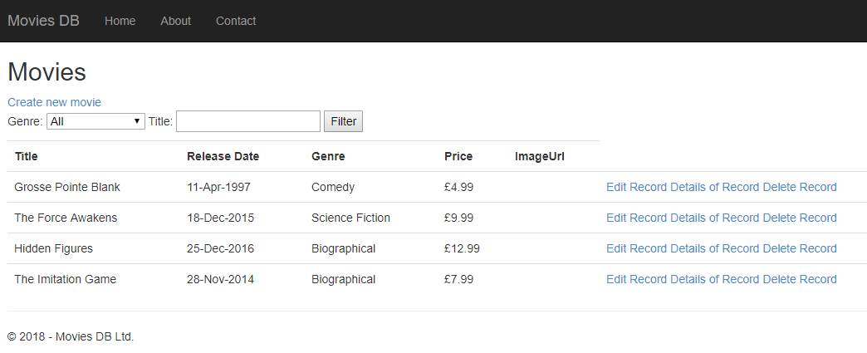
Styling the Index view
The Index view works well, but is messy
In the <table> tag, add class=“table”
This is the result

Slide 30
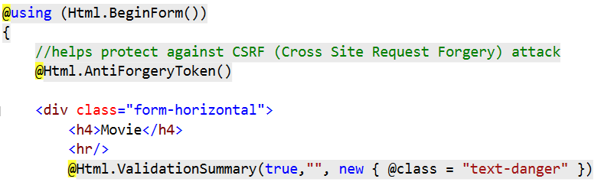
Styling the Create view
The Create view works well, but looks terrible
The labels and input boxes should be arranged vertically
Start by adding a div with class=“form-horizontal” above the Movie heading
The closing div tag should go just before the } at the end of the form
Add a horizontal rule below the Movie heading
Add the parameters: true, “”, new {@class = “text-danger”} to Html.Validation summary
True means it will only show model-level errors (not errors for individual fields, as these error messages will be added below each field)
“” is where a message could be added
new { @class = "text-danger" } is where a CSS class is added to make the text red in case of an error

Slide 31
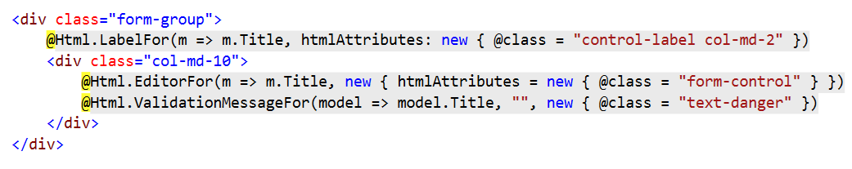
Styling the Create view
Each label and text box pair should be styled as shown below
Brings the label and input box over to the left
Aligns the label
Creates a column 2 units wide
Creates a column 10 units wide
Adds an error message for the field
Makes the text red
Styles the input box with grey edges, rounded corners, etc.
Error message text could be added here. If it’s left blank, the error messages from the data annotations in the model class are used

Slide 32
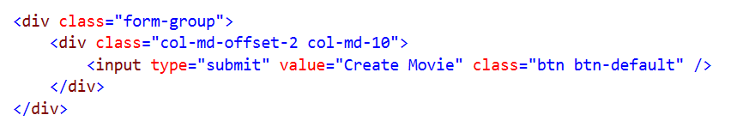
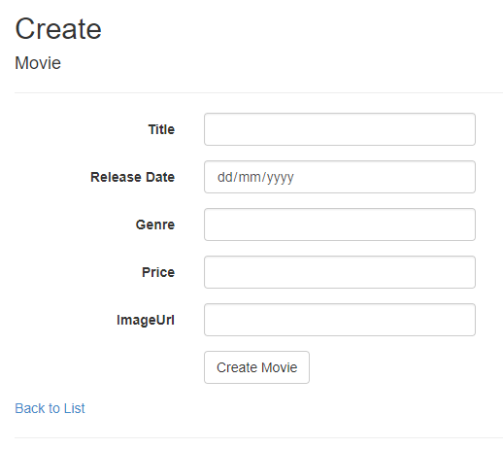
Styling the Create view
The button should be styled as shown below
Aligns the button with the other form elements
Moves the next column over by 2 units
Creates a column 10 units wide
Styles the button with rounded corners and light background, etc.
The Create view now looks much better
The same styling should now be applied to the Edit view

Slide 33
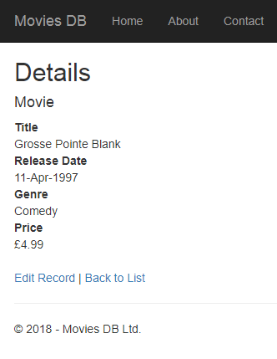
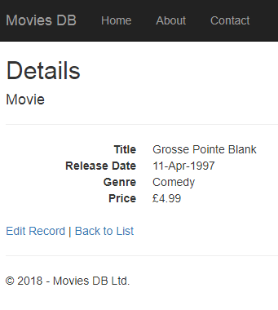
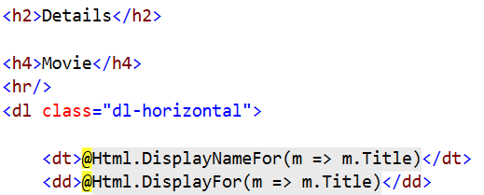
Styling the Details view
The styling of the Details view could also be improved
Add a horizontal rule <hr/> under the <h4> Movie</h4> heading
Add a class=“dl-horizontal” to the <dl> tag
The labels and information in the Details view are now arranged horizontally, which is a bit easier to read

Slide 34
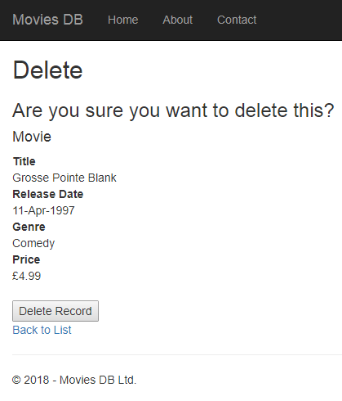
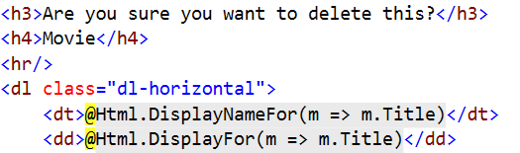
Styling the Delete view
The styling of the is very similar to the Details view, though there is also a bit of extra styling on the button
Add a horizontal rule <hr/> under the <h4> Movie</h4> heading
Add a class=“dl-horizontal” to the <dl> tag
The styling for the button is on the next slide
Unstyled version

Slide 35
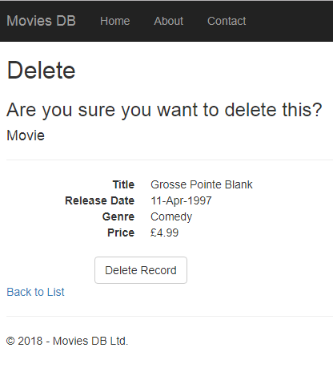
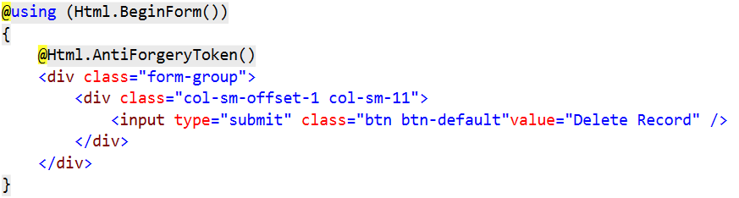
Styling the Delete view
The button is put in a form group (which increases the space around it) by wrapping it in a <div class=“form-group”>
It is moved over – away from the Back to List link, so it’s not clicked accidentally – by putting another div inside the first one: <div class="col-sm-offset-1 col-sm-11">
Then the button is styled by adding class=“btn btn-default” to the <input> tag
Styled version

Slide 36
Testing

Slide 37
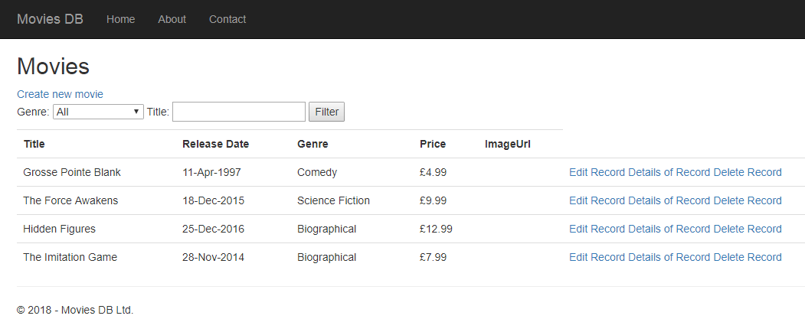




MVC Movies is finished and styled
The functionality of MVC Movies is finished
Creating, reading, updating and deleting records from a database
Searching records by title and filtering by genre
It has also been styled
There are some additional options
Tidying up memory by releasing unused resources
Adding images using URLs

Slide 38

Tidying up memory by releasing unused resources
It is good practice to dispose of any resources in an application as soon as you are finished with them
This releases memory and may improve performance
You can do this by adding a Dispose method to the HomeController
This method is called automatically by the application whenever it’s needed
The using in using(@Html.BeginFor()) tells MVC to release the resources for the form as soon as they are no longer needed

Slide 39
Images

Slide 40

Getting image URLs from the web
You can add images to the application easily by using URLs
These can be URLs from the web
You can also use images that you have added to the project in Visual Studio
To get an image URL from the web:
Do a Google Images search to locate it
Open the page with the image
Right-click on the image and select open in new tab
Then copy the URL using the menu or from the address bar
In the application, edit the record, adding the URL
For now, the text of the URL will display, but this is easy to render as an image

Slide 41


Getting URLs for image files
If you want to link to an image through Visual Studio
Add the image file to the Content folder by right-clicking on the folder and selecting Add -> Existing Item
Once the image file has been added, drag it into any view
An HTML <img> tag will be created, which contains the URL
Copy the URL from the tag
Edit the relevant record, adding the URL
The <img> tag can be deleted
For now, the text of the URL will display, but this is easy to render as an image

Slide 42


Rendering URLs as images
At the moment, you can see the text of the URLs
To render them as images, go into the Index view and, in the foreach loop, replace @Html.DisplayFor(m => item.ImageUrl) with <img src="@Url.Content(item. ImageUrl)" height="100" />

Slide 43


Rendering URLs as images
The URLs should now display as images
Non-existent URLs will display as broken links
If a URL is null, the application will now crash, as the Url.Content helper won’t accept null values
To prevent this, add the code below to the POST Create and Edit methods, to save a default value for the ImageUrl (of course, please make your own choice of URL)

Slide 44

Rendering URLs as images
Now, the application should add a default image if a record is created (or edited) with a null value for ImageUrl
One last thing – the ImageURL heading on the Index page is redundant, so could be removed from the Index view by deleting <th>@Html.DisplayNameFor (model => model.ImageUrl)</th>
This is now a working application with useful functionality

Slide 45

Next steps
This application is good preparation for your second project, which should be a single-table database with CRUD functionality
There are many possible improvements, e.g.
Improve the appearance – definitely get rid of the black menu bar at the top and do some other styling
Like/Dislike buttons are possible – an AJAX call is ideal to reduce flicker
Embedded video on the Details page would be nice – you can use an iframe for this
Feel free to use your imagination – choose a topic you’re interested in and have fun!

